Slide 1




Business Problem
How is Amazon doing relative to other apps? Badly (What is our proof?) Why are they doing badly? What is our proof? What would we consider doing if we had more time? How do we use this in the future?

Slide 2
Methodology
Coded in R
Collect reviews from online
Parse and clean data
Model sentiment by relating words to average star rating to create dictionary
Perform sentiment analysis using custom dictionary
Perform topic modeling
Compare topics to sentiment
Create predictive model of positive/negative sentiment with logistic regression

Slide 3
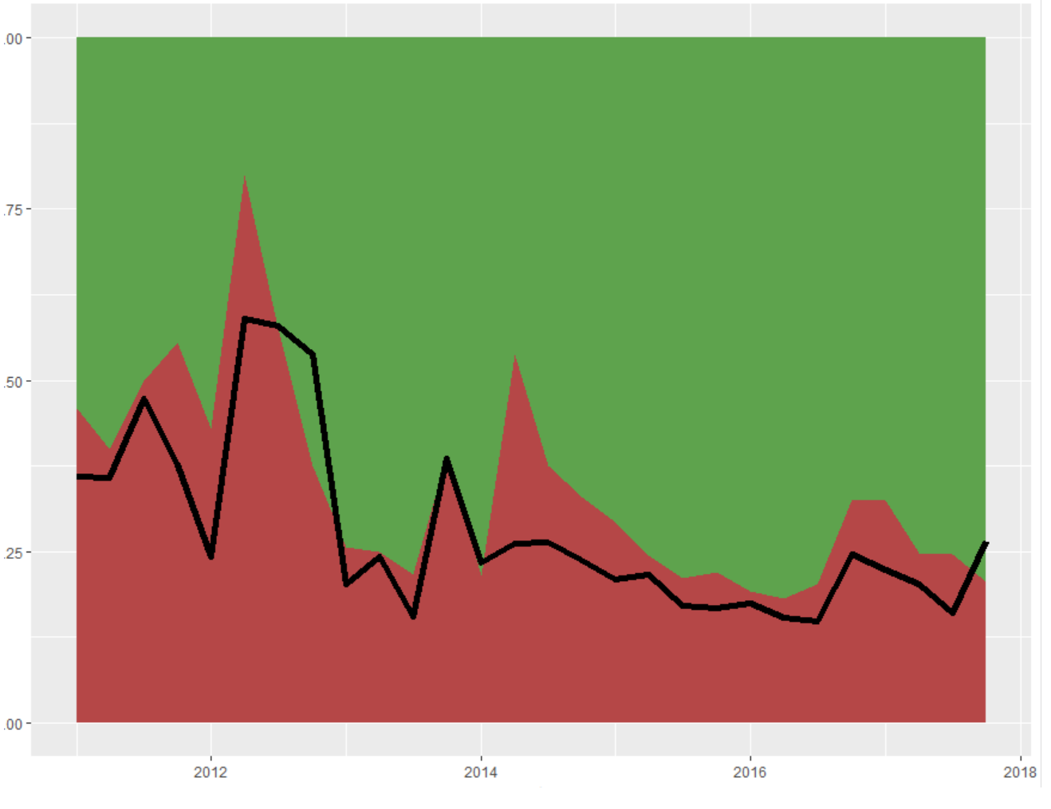
How is Amazon doing (relative to competitors)
Show without prediction lines

Slide 4
Why the negativity? Negative Keywords
How do we choose negative words?
Store
Crash
Horrible
Commercial

Slide 5
Relate negative words to Sentiment chart

Slide 6
But what are we doing well? Positive Topics
Based on a Topic Model analysis, we’ve identified 4 topics creating a coherent story that powers the positive ratings for Amazon Music:
Amazon Device Friendly
Amazon Prime
Better than Pandora
Free & Easy

Slide 7
Relate positive topics to Sentiment chart

Slide 8
Sentiment Model
Key positive / negative words?
Accuracy ratings
Model Parameters and R2
How would we recommend using?

Slide 9
Plot model vs actual

Slide 10
In the Future…
Wish we could work on Topic models more to come up with a business story with respect to the data we have
Wish we could use the topic analysis of each review to predict the sentiment
Wish sentiment would predict the star rating instead of positive/negative only
We can expand our research if can get data from Apple store or google play store to build on this analysis.
We could run similar thematic study or sentiment analysis on Facebook posts, twitter or Pinterest etc.
Run similar analysis for the competitors especially if we observe significant changes in customer sentiment after a major improvement or new feature.
Use this sentiment predictor to test a new feature with a set of selected customers (based on their reviews).
Suggest to the marketing team to upsell to customers who are giving good reviews consistently which can help in creating brand loyalty.
The negative reviews for issues such as bad speed, ease of access etc. System could be developed that IT team or software development team can be notified. It can help troubleshoot the problems.

